Slide 1



This is Good
Period | Tier Analysis |  | Company
Customer Name
Customer #
Tier
State
Quarters
Years
Avg. Time On Dock (in hours): | 3 | Peer Avg. Time On Dock (in hours): | 3
Avg. Lbs Per Period: | 311,500 | Peer Avg. Lbs Per Period: | 311,500
Avg. # Of POs Per Load: | 2.9 | Peer Avg. # Of POs Per Load: | 2.9
Avg. Cases Per Load: | 1,684 | Peer Avg. Cases Per Load: | 1,684
Avg. Lines Per Load: | 182 | Peer Avg. Lines Per Load: | 182
Avg. Cases Per Line: | 9 | Peer Avg. Cases Per Line: | 9
Avg. % Item Spread: | 4% | Peer Avg. % Item Spread: | 4%

Slide 2
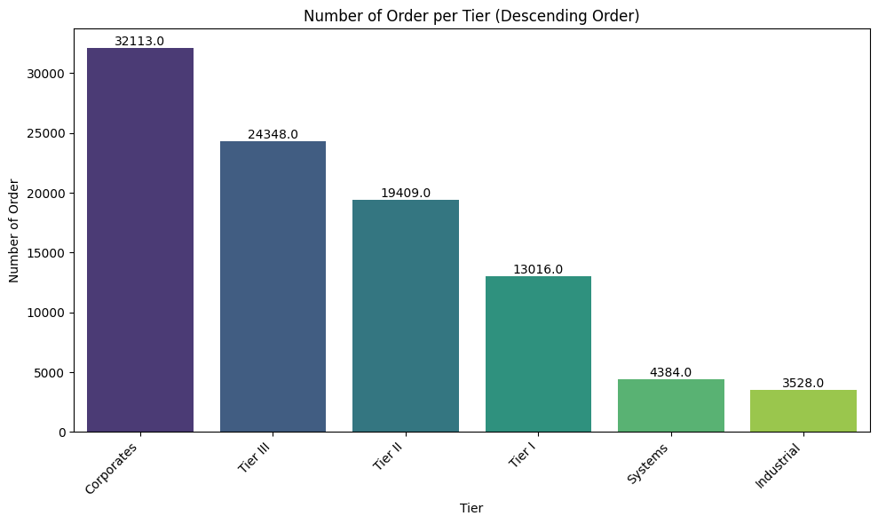
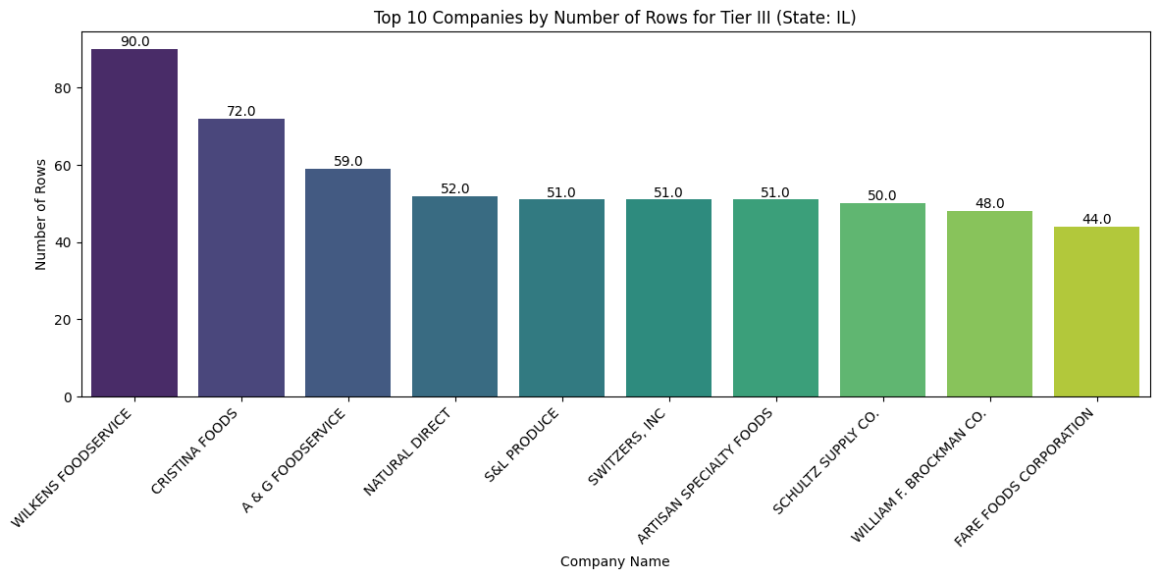
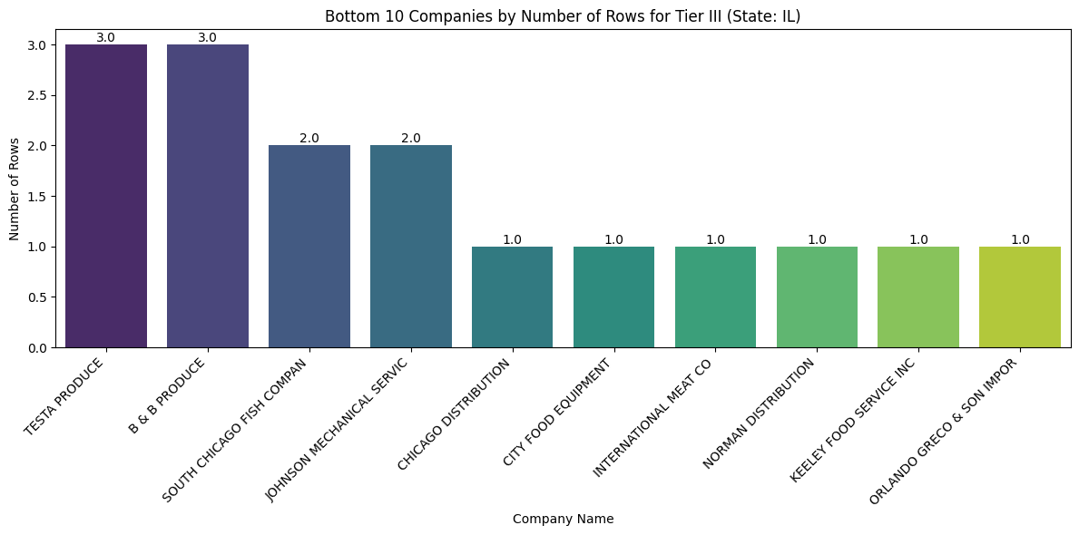
Company | Tier Analysis |  | Company
Customer Name
Customer #
Tier
State
Add titles
Average numbers of all metrics
Avg. Time On Dock (in hours): | 3 | Peer Avg. Time On Dock (in hours) Per Tier: | 3
Avg. Lbs Per Period: | 311,500 | Peer Avg. Lbs Per Tier: | 311,500
Avg. # Of POs Per Load: | 2.9 | Peer Avg. # Of POs Per Tier: | 2.9
Avg. Cases Per Load: | 1,684 | Peer Avg. Cases Per Tier: | 1,684
Avg. Lines Per Load: | 182 | Peer Avg. Lines Per Tier: | 182
Avg. Cases Per Line: | 9 | Peer Avg. Cases Per Tier: | 9
Avg. % Item Spread: | 4% | Peer Avg. % Item Spread Tier: | 4%
Average numbers of all Metrics but specific tiers
Change it based on weights instead of order.
Top 10 and Bottom 10 Per weights per company

Slide 3
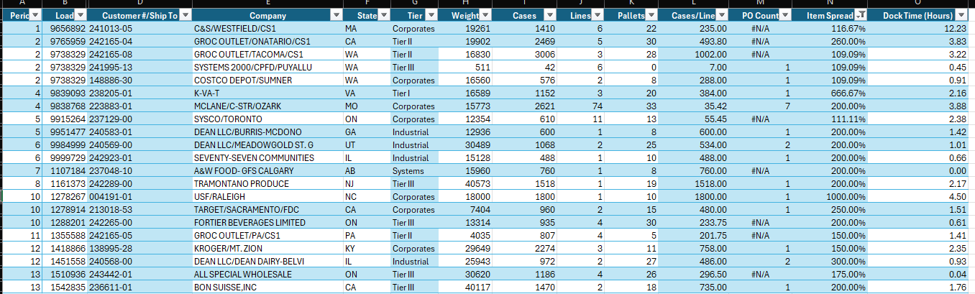
Company | Tier Analysis |  | Company
Customer Name
Customer #
Tier
State
Low performing or high performing
Highlight red if low performing, for example low dock times. And highlight green for high perfoming for example high volume

